Slide 1


TEAM 1
Avni Mitawalkar
Daksh Rawat
Divya Kotapati
Nikita Jarile
Sanket Koli
Sen Wang

Slide 2
GitHub URL
https://github.com/nikitajarile/Computer-Science-Project-1

Slide 3
Login Information
Username – NikitaJarile
Password - NikitaJarile

Slide 4
Repository Structure

Slide 5
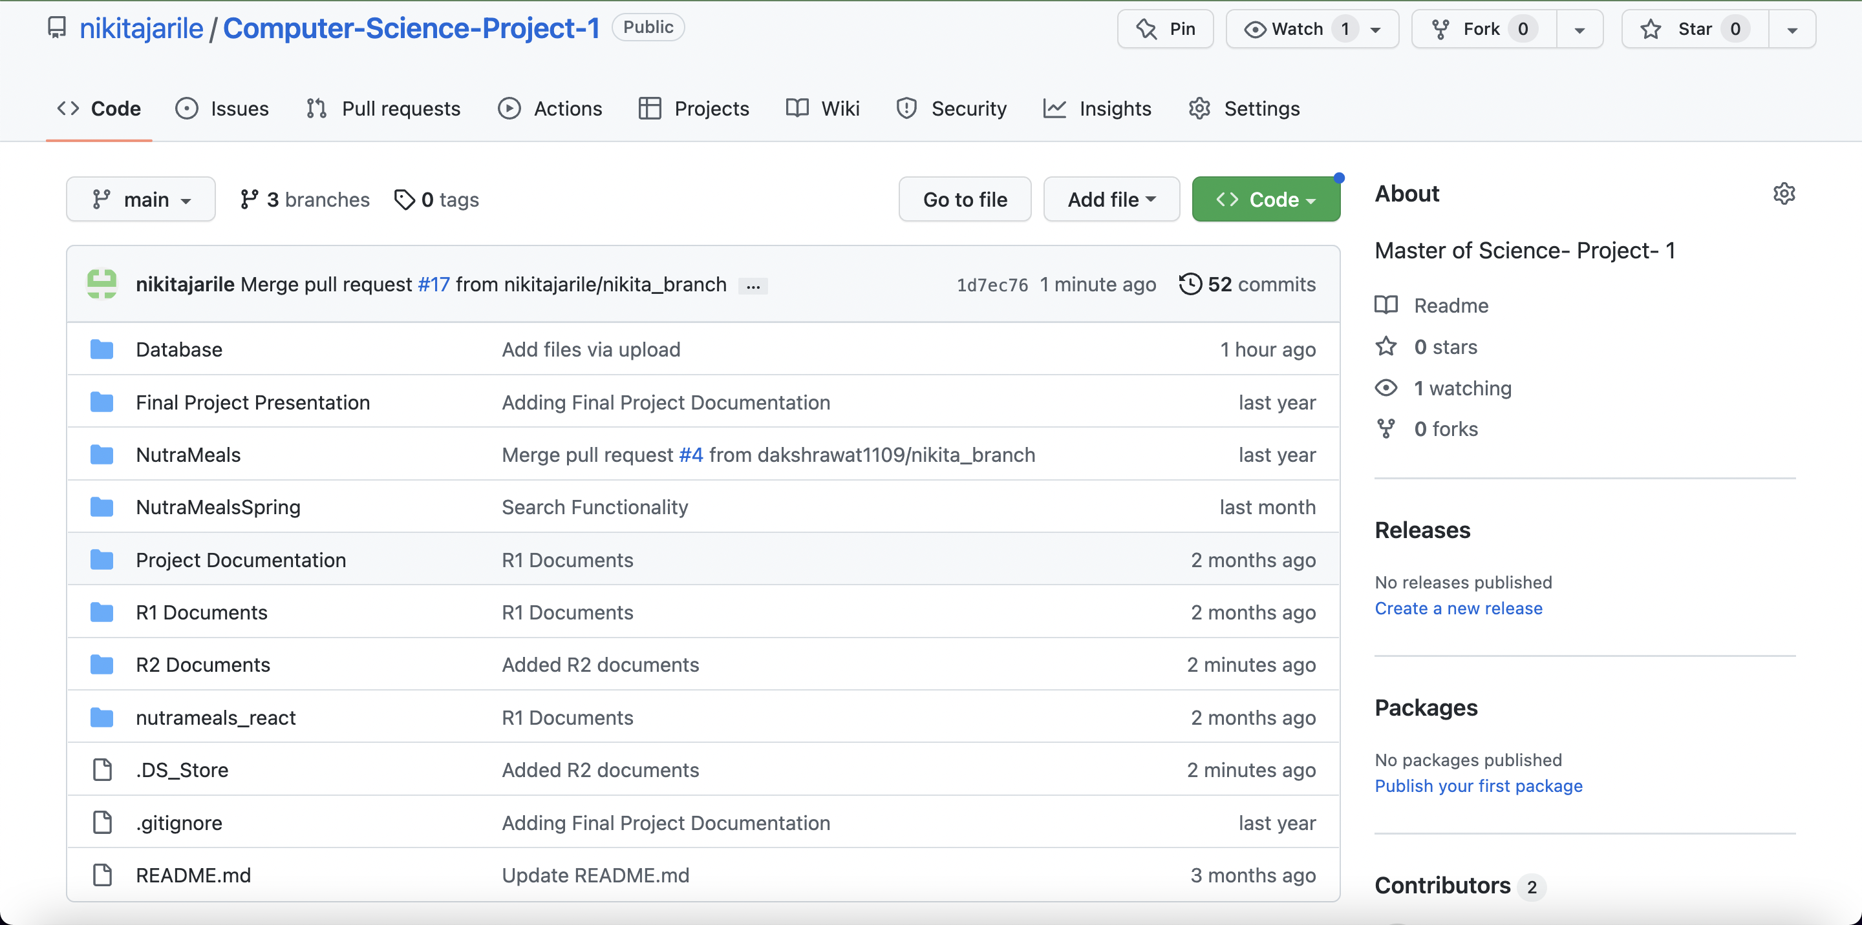

Slide 6
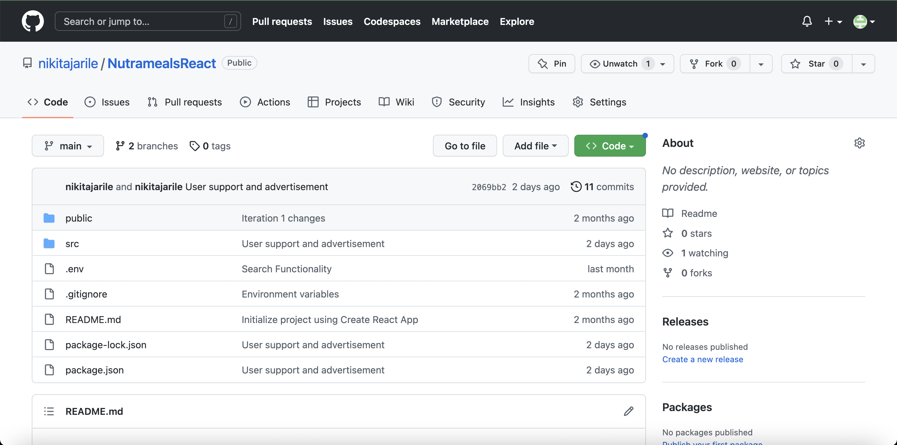

Slide 7
Build & Deployment Procedure

Slide 8
Prerequisites
Java, Eclipse, NodeJS, ReactJS, VSCode, MySQL
Must be installed on local machine

Slide 9
MySQL => Run “Create_table_nutrameal.sql” from Database folder
Installation Steps
(local machine)
Java Code
Clone repository to your local machine.
Import the code from NutraMealsSpring folder to eclipse
Run MainApplication.java
Application would run on :
http://localhost:8080
React Code
Clone repository to your local machine.(https://github.com/nikitajarile/NutramealsReact)
Import the code from to VS code
Go to project root folder in terminal and run the commands :
npm install
npm start
Application would run on :
http://localhost:3000

Slide 10
Deployment to DEV AND QA nodes
(AWS EC2s)
Commit code to GitHub
Go to Jenkins
http://3.84.40.243:8080
(Dev Node)
Run
DevPipeline
Node_pipeline
Dev Node
Code deploys to
(QA Node)
Run
QAPipeline
QAPipeline_react
QA Node
Code deploys to

